Slide 1
GROUP 3 Aaqib Ur Rehman Ajay Kumar Yadav Bhavana C Dileep Bandi Laveena R
094049_IN
093943_IN
093938_IN
093940_IN 093951_IN

Slide 2
Pre-Boot Sequence(BIOS)
Understanding the linux boot and startup processes is important to being able to both configure linux and to resolving startup issues.
In reality, there are two sequences of events that are required to boot a linux computer and make it usable: boot and startup.
The boot sequence starts when the computer is turned on, and is completed when the kernel is initialized and systemd is launched.
The startup process then takes over and finishes the task of getting the linux computer into an operational state.

Slide 3
Pre-Boot Sequence BIOS (CONTD..)
The linux boot and startup process is fairly simple to understand. It is comprised of the following steps which will be described in more detail in the following sections.
Bios post
Boot loader (GRUB2)
Kernel initialization
Start systemd, the parent of all processes.

Slide 4
The boot process
The boot process can be initiated in one of a couple ways.
First, if power is turned off, turning on the power will begin the boot process.
If the computer is already running a local user, including root or an unprivileged user, the user can programmatically initiate the boot sequence by using the gui or command line to initiate a reboot. A reboot will first do a shutdown and then restart the computer.

Slide 5
BIOS POST
When power is first applied to the computer it runs the POST (power on self test) which is part of the BIOS (basic I/O system).
Post is the part of bios whose task is to ensure that the computer hardware functioned correctly.
If post fails, the computer may not be usable and so the boot process does not continue.
Bios post checks the basic operability of the hardware and then it issues a bios interrupt, int 13h, which locates the boot sectors on any attached bootable devices.

Slide 6
BIOS POST (CONTD..)
The first boot sector it finds that contains a valid boot record is loaded into RAM and control is then transferred to the code that was loaded from the boot sector.
There are three boot loaders used by most linux distributions, grub, grub2, and lilo. GRUB2 is the newest and is used much more frequently these days than the other older options.

Slide 7
GRUB2
GRUB2 stands for "grand unified bootloader, version 2" and it is now the primary bootloader for most current linux distributions.
Grub2 is the program which makes the computer just smart enough to find the operating system kernel and load it into memory.
Grub2 can also allow the user to choose to boot from among several different kernels for any given linux distribution.
Grub can be configured using the /boot/grub/grub.Conf file.

Slide 8
Kernel
All of the kernels are in a self-extracting, compressed format to save space. The kernels are located in the /boot directory, along with an initial RAM disk image, and device maps of the hard drives.
After the selected kernel is loaded into memory and begins executing, it must first extract itself from the compressed version of the file before it can perform any useful work.
Once the kernel has extracted itself, it loads systemd, which is the replacement for the old sysv init program, and turns control over to it.
This is the end of the boot process. At this point, the linux kernel and systemd are running but unable to perform any productive tasks for the end user because nothing else is running.

Slide 9
The startup process
Systemd is the mother of all processes and it is responsible for bringing the linux host up to a state in which productive work can be done.
First, systemd mounts the filesystems as defined by /etc/fstab, including any swap files or partitions. At this point, it can access the configuration files located in /etc, including its own.
It uses its configuration file, /etc/systemd/system/default.Target, to determine which state or target, into which it should boot the host.

Slide 10
Boot Loader
A boot loader is a small program stored in the MBR or GUID partition table that helps to load an operating system into memory.
Without a boot loader, your operating system can not be loaded into memory.
There are several boot loaders we can install together with linux on our systems
Grub
Lilo
Burg
Syslinux

Slide 11
Linux loader (LILO)
Default boot loader for most linux distributions.
Lilo supports only up to 16 different boot selections.
Lilo cannot boot from network.
Lilo must be written again every time you change the configuration file.
Lilo does not have an interactive command interface.

Slide 12
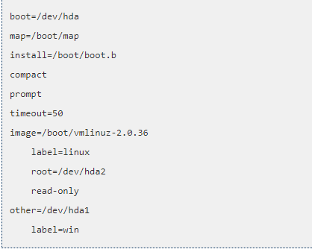
LILO file
Location: /etc/lilo.conf
How does the lilo config file look like?

Slide 13
Grand Unified Boot loader (GRUB)
GRUB was developed from a package called the grand unified bootloader
Supports multiboot
Supports multiple hardware architectures and operating systems.
Offers a bash-like interactive command line interface.
Supports setting of passwords with encryption for security.
Supports booting from a network.

Slide 14
Initial boot loader phase (Grub )
GRUB stage 1 (MBR and mainly points to stage 2)
Grub stage 1.5 (contains file system driver's)
Grub stage 2 (configuration file or manual configuration)

Slide 15
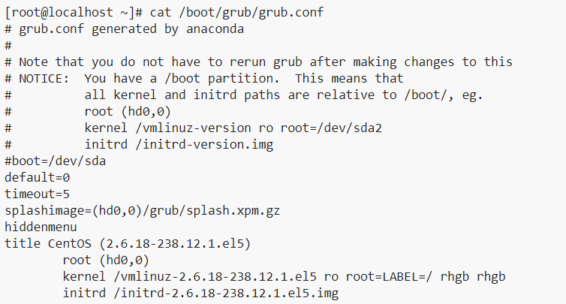
Grub File
Location: /boot/grub/grub.conf
How does the grub config file look like?

Slide 16
Linux runlevels:
Runlevels act as a method to define what processes are started and stopped, and what users are capable of doing by managing each level individually.
There were 10 runlevels available (0-9).
Red Hat/Fedora Linux uses 7 of them (0-6)

Slide 17
Run Levels and the Initialization Process:
ID | Name | Description
0 | Halt | Shuts down the system.
1 | Single-user mode | Mode for administrative tasks.
2 | Multi-user mode | Does not configure network interfaces and does not export networks services.
3 | Multi-user mode with networking | Starts the system normally.
4 | Not used/user-definable | For special purposes.
5 | Start the system normally with appropriate display manager (with GUI) | Same as runlevel 3 + display Manager.
6 | Reboot | Reboots the system.

Slide 18
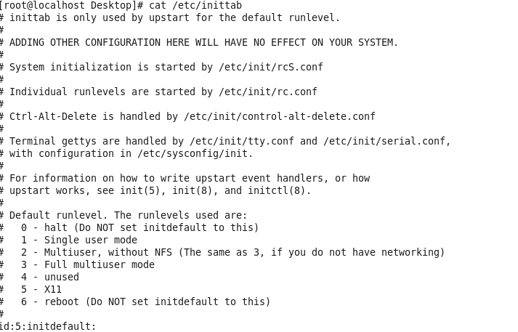
How to change the run levels?
To check where the run level is?

Slide 19
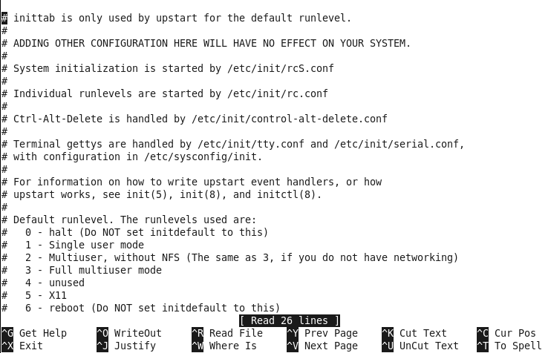
How to change the run level ?
nano /etc/inittab

Slide 20
Kernel boot process
A Linux kernel is responsible for handling process management, memory management, users, inter process communication etc.
Kernel is a compressed image file.
If you have RAID configured it required different set of programs and code.
But our kernel image file needs to be smaller, that's the reason its compressed image file.
Initrd is sometimes called as initial root file system. This is used by the kernel before the real root file system is mounted. Initrd is available in the form of an image similar to the kernel image file.

Slide 21
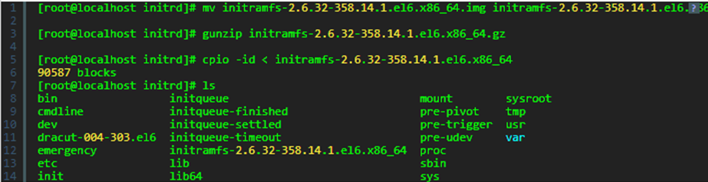
If you see the above commands, we have first uncompressed the initrd image file, then we can view the contents of that file with the help of cpio command.
Loading and unloading of kernel modules is done with the help of programs like insmod, and rmmod present in the initrd image.
Now as the kernel is loaded into the memory, the execution begins by checking the processor family and architecture.
Since kernel is the first program executed the program id will be 1 and default run level will be 3.

Slide 22
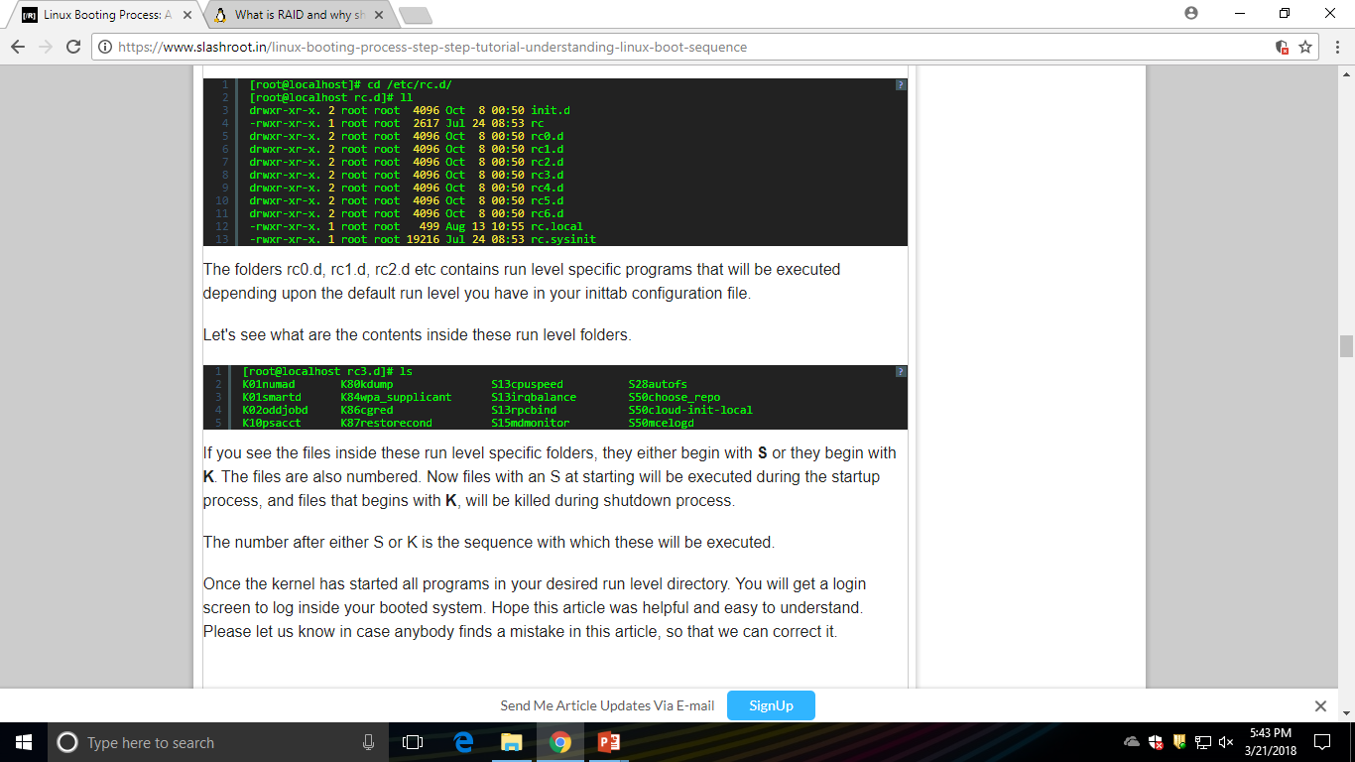
Let's see what are the contents inside these run level folders.
If you see the files inside these run level specific folders, they either begin with S or they begin with K. The files are also numbered.
Now files with an S at starting will be executed during the startup process, and files that begins with K, will be killed during shutdown process.
The number after either S or K is the sequence with which these will be executed.
Once the kernel has started all programs in your desired run level directory. You will get a login screen to log inside your booted system.

Slide 23
INIT
Initialization is the process of locating and using the defined values for variable data that is used by a computer program.
For example, an operating system or application program is installed with default or user-specified values that determine certain aspects of how the system or program is to function.

Slide 24
INIT(cont.)
The init process is the last step in the boot procedure and identified by process id "1". Init is responsible for starting system processes as defined in:
Sysv systems like RHEL 1-6, fedora 1-14: /etc/inittab
Systemd fedora 15+: /lib/systemd/system/default .Target (this is a symbolic link) and the files in /etc/systemd/system/ and /lib/systemd/system/

Slide 25
INIT 6
In linux, the init 6 command gracefully reboots the system running all the K* shutdown scripts first, before rebooting.
The reboot command does a very quick reboot. It doesn't execute any kill scripts, but just unmounts filesystems and restarts the system.
The reboot command is more forceful.

Slide 26
INITTAB FILE
It controls the initialization process
The /etc/inittab file supplies the script to the init command's role as a general process dispatcher.
The process that constitutes the majority of the init command's process dispatching activities is the /etc/getty line process, which initiates individual terminal lines.

Slide 27
Inittab file- (cont.)
Other processes typically dispatched by the init command are daemons and the shell.
The /etc/inittab file is composed of entries that are position-dependent and have the following format:
Identifier:runlevel:action:command

